Slide 1
For DPS Rohtak
School Mobile Application

Slide 2
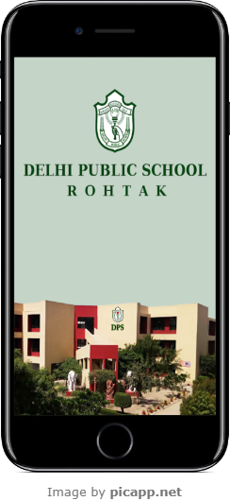
Steps to download
Open Google Play Store/ Apple Store
Search for DPS Rohtak
Download the app
Allow permissions, if asked
Sign in with your username and password

Slide 3
Mobile Application For Parents
Online Payment Gateway
Student Daily Attendance
School Calendar & Events
Communication
Report Card
Push Notification
Homework and Assignments
Photo Gallery

Slide 4
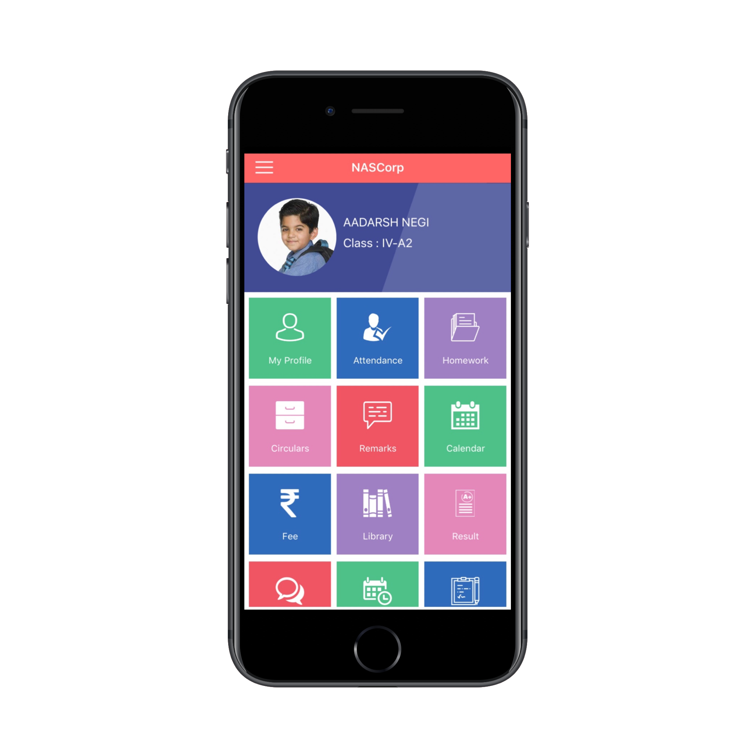
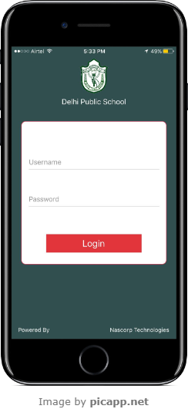
USER LOGIN
User Login
Home Page

Slide 5
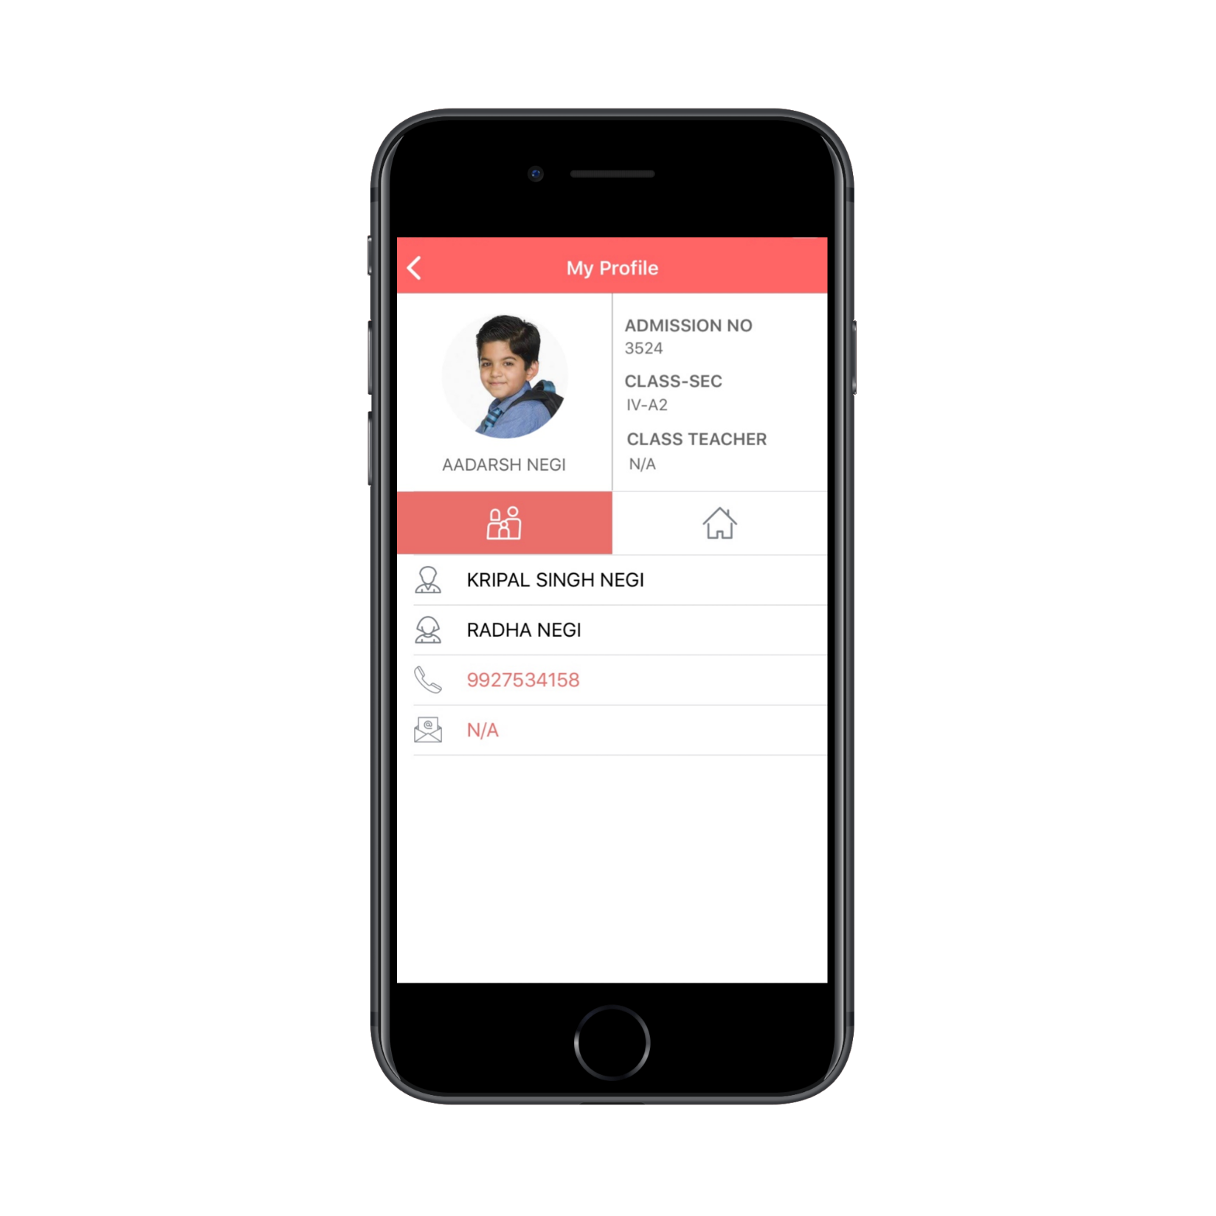
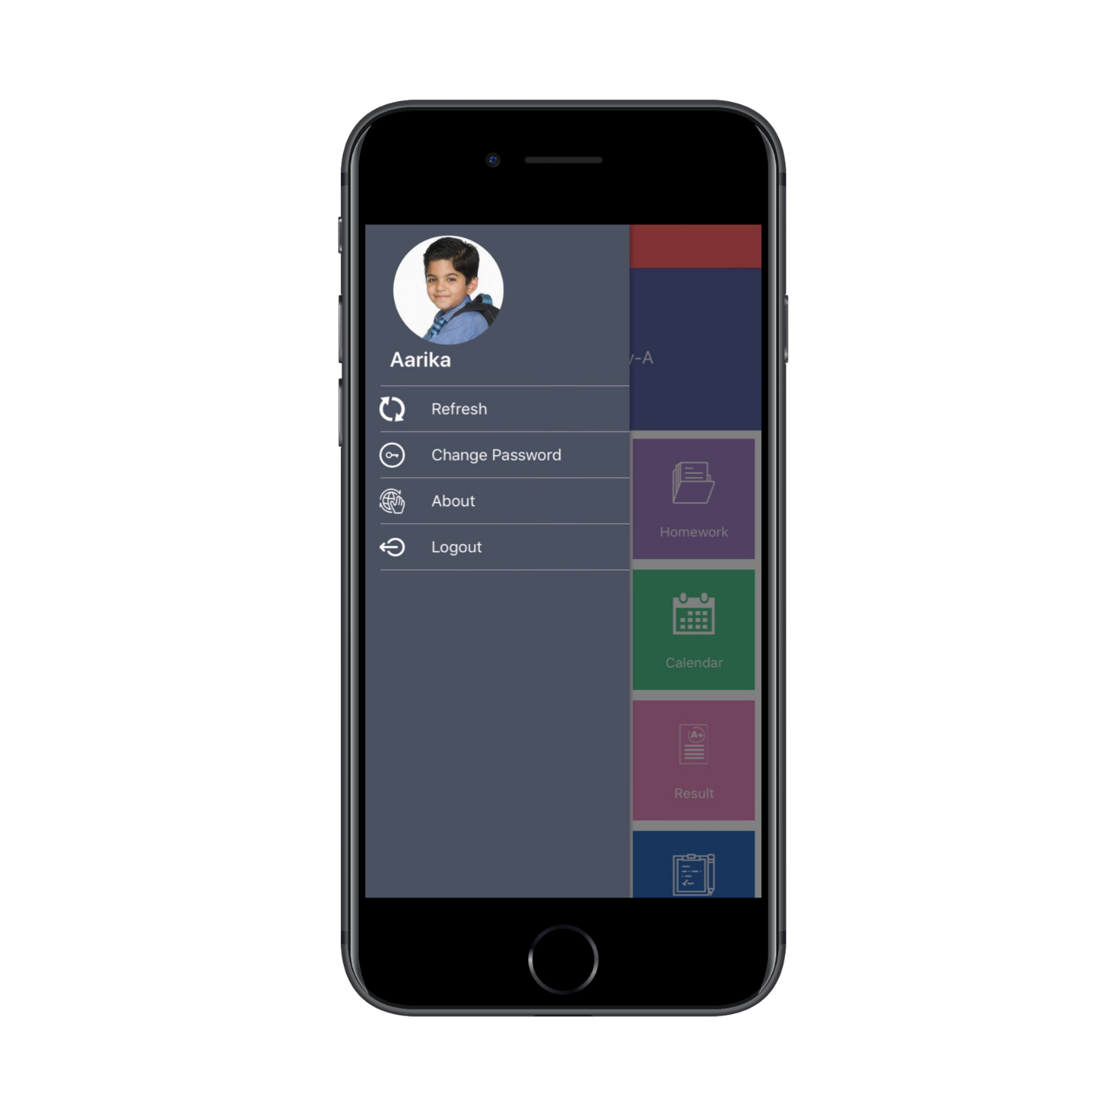
STUDENT PROFILE
Student Profile
Change Password

Slide 6
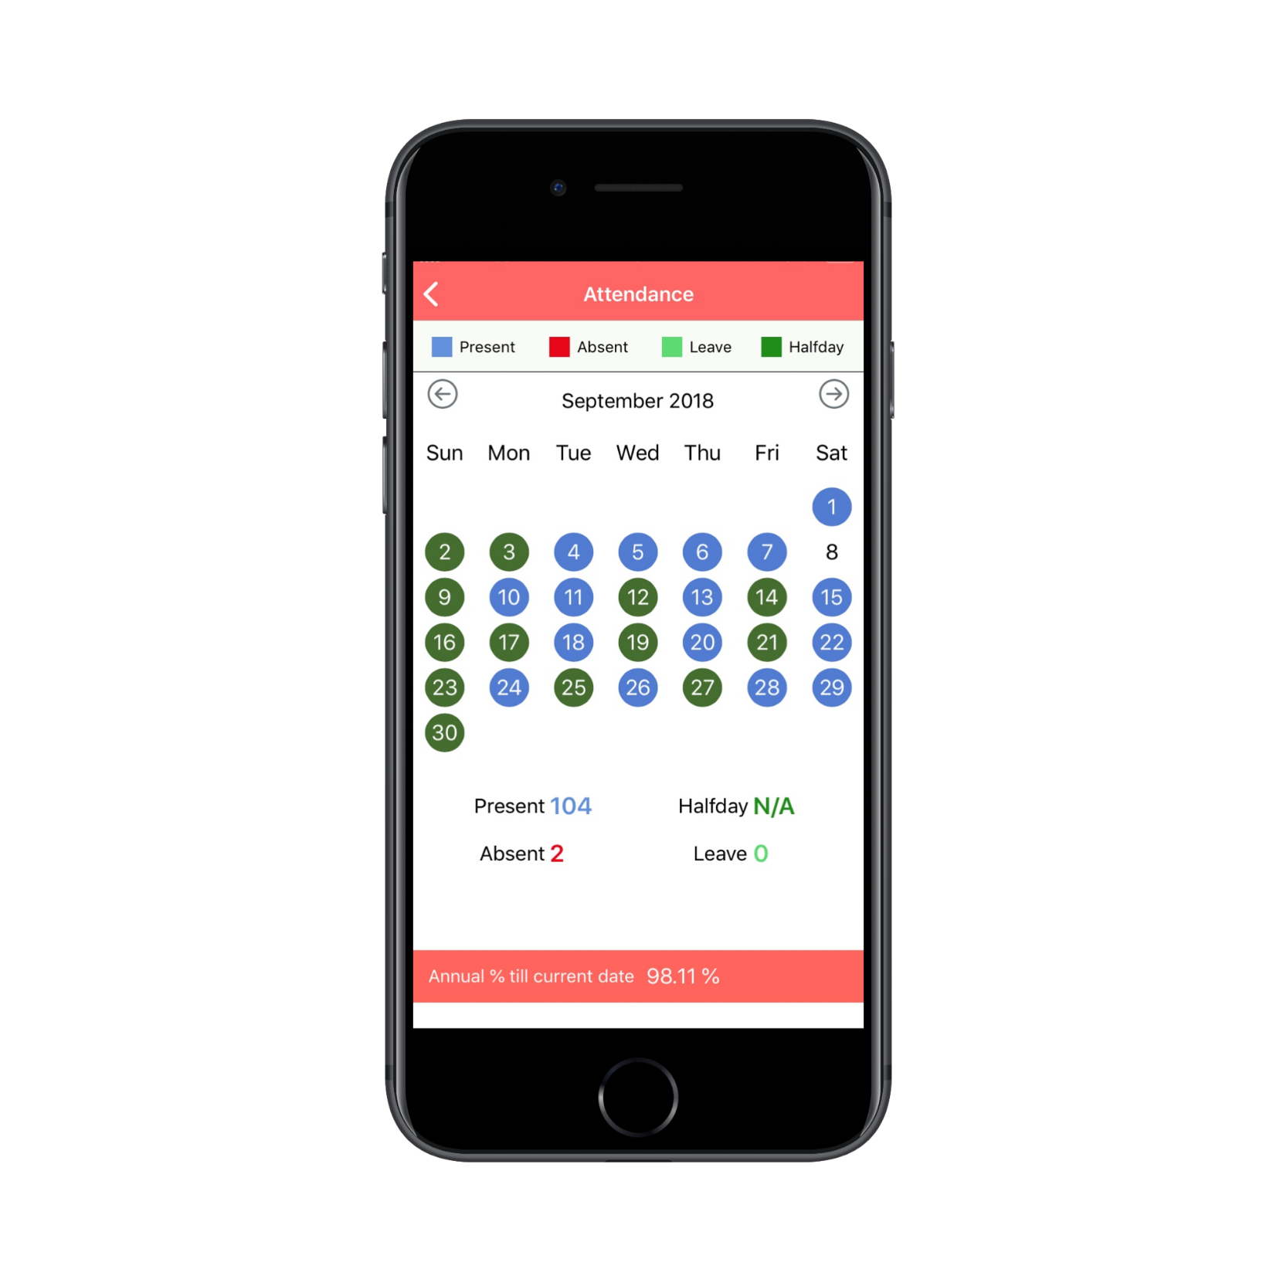
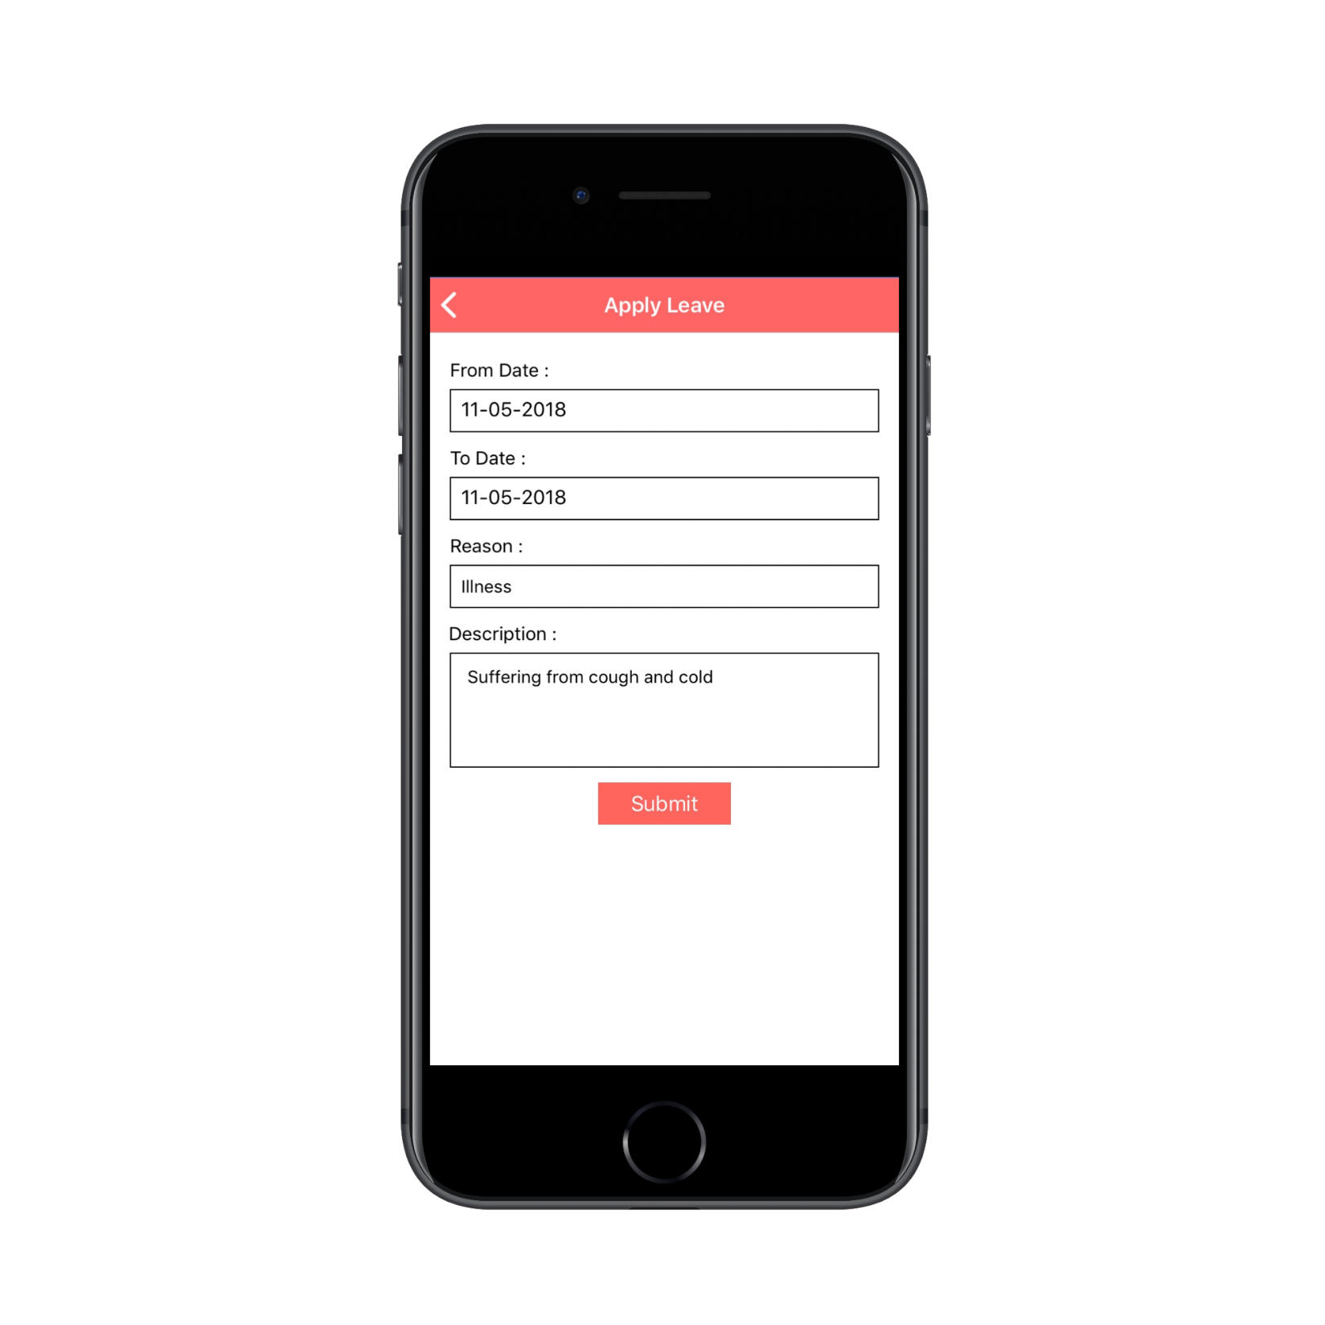
STUDENT ATTENDANCE
Daily Attendance
Apply Leave Online

Slide 7
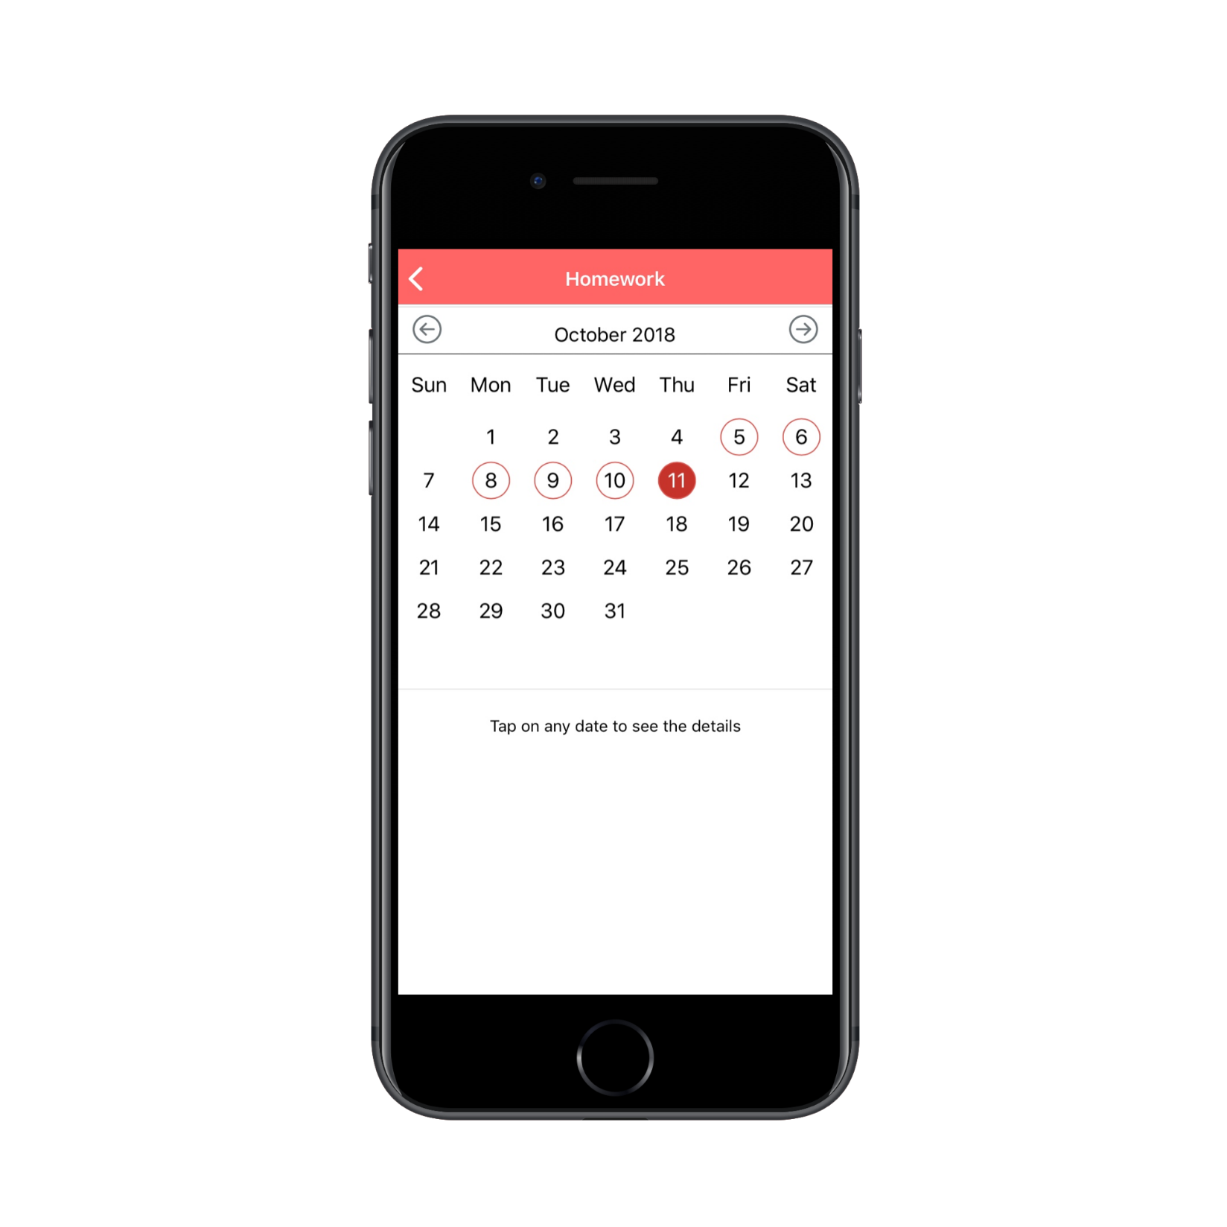
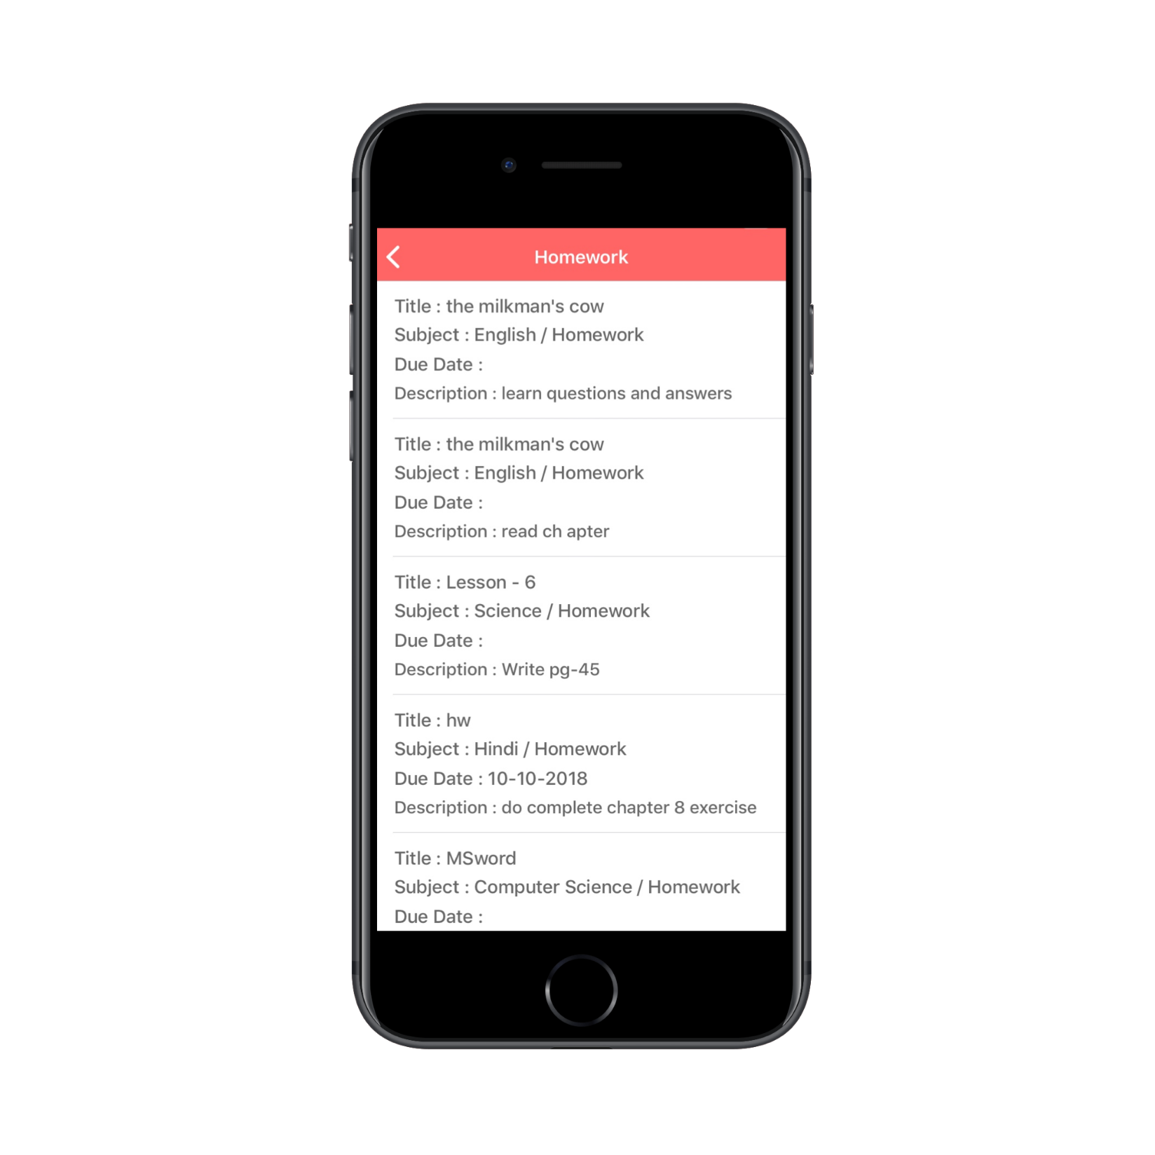
HOMEWORK/ASSIGNMENT
Daily Homework
Homework details

Slide 8
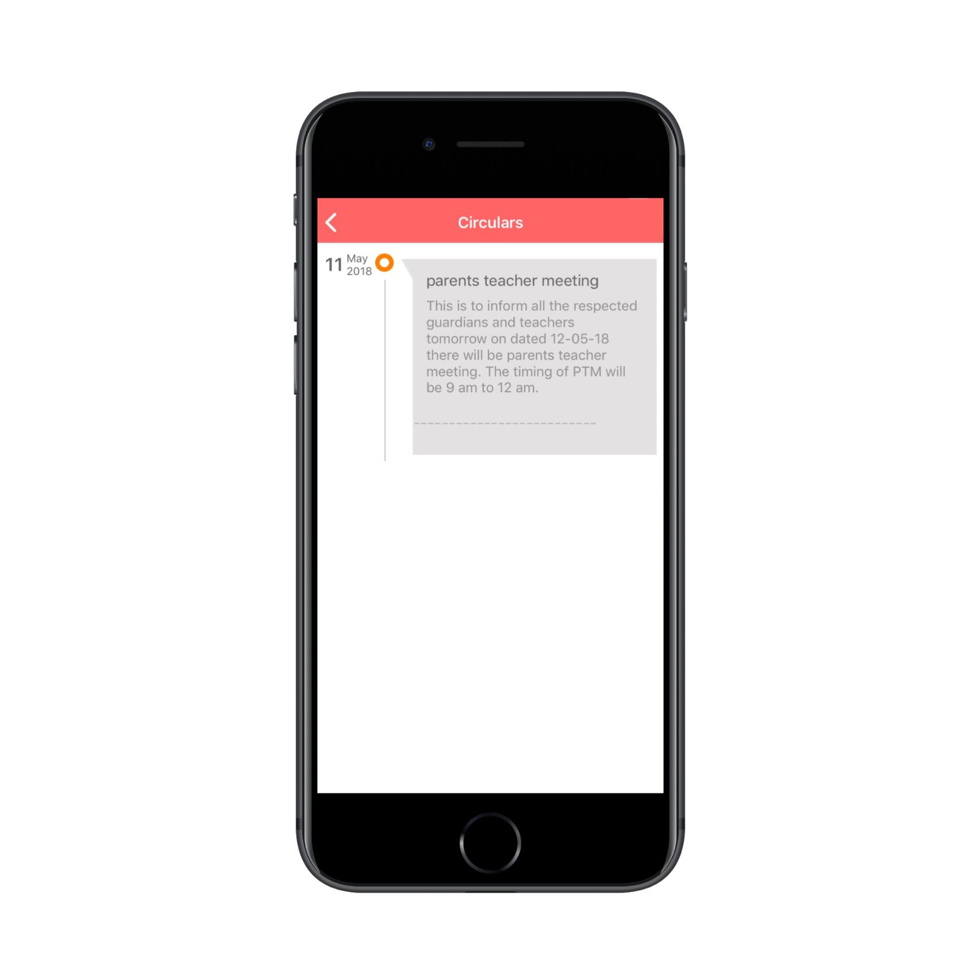
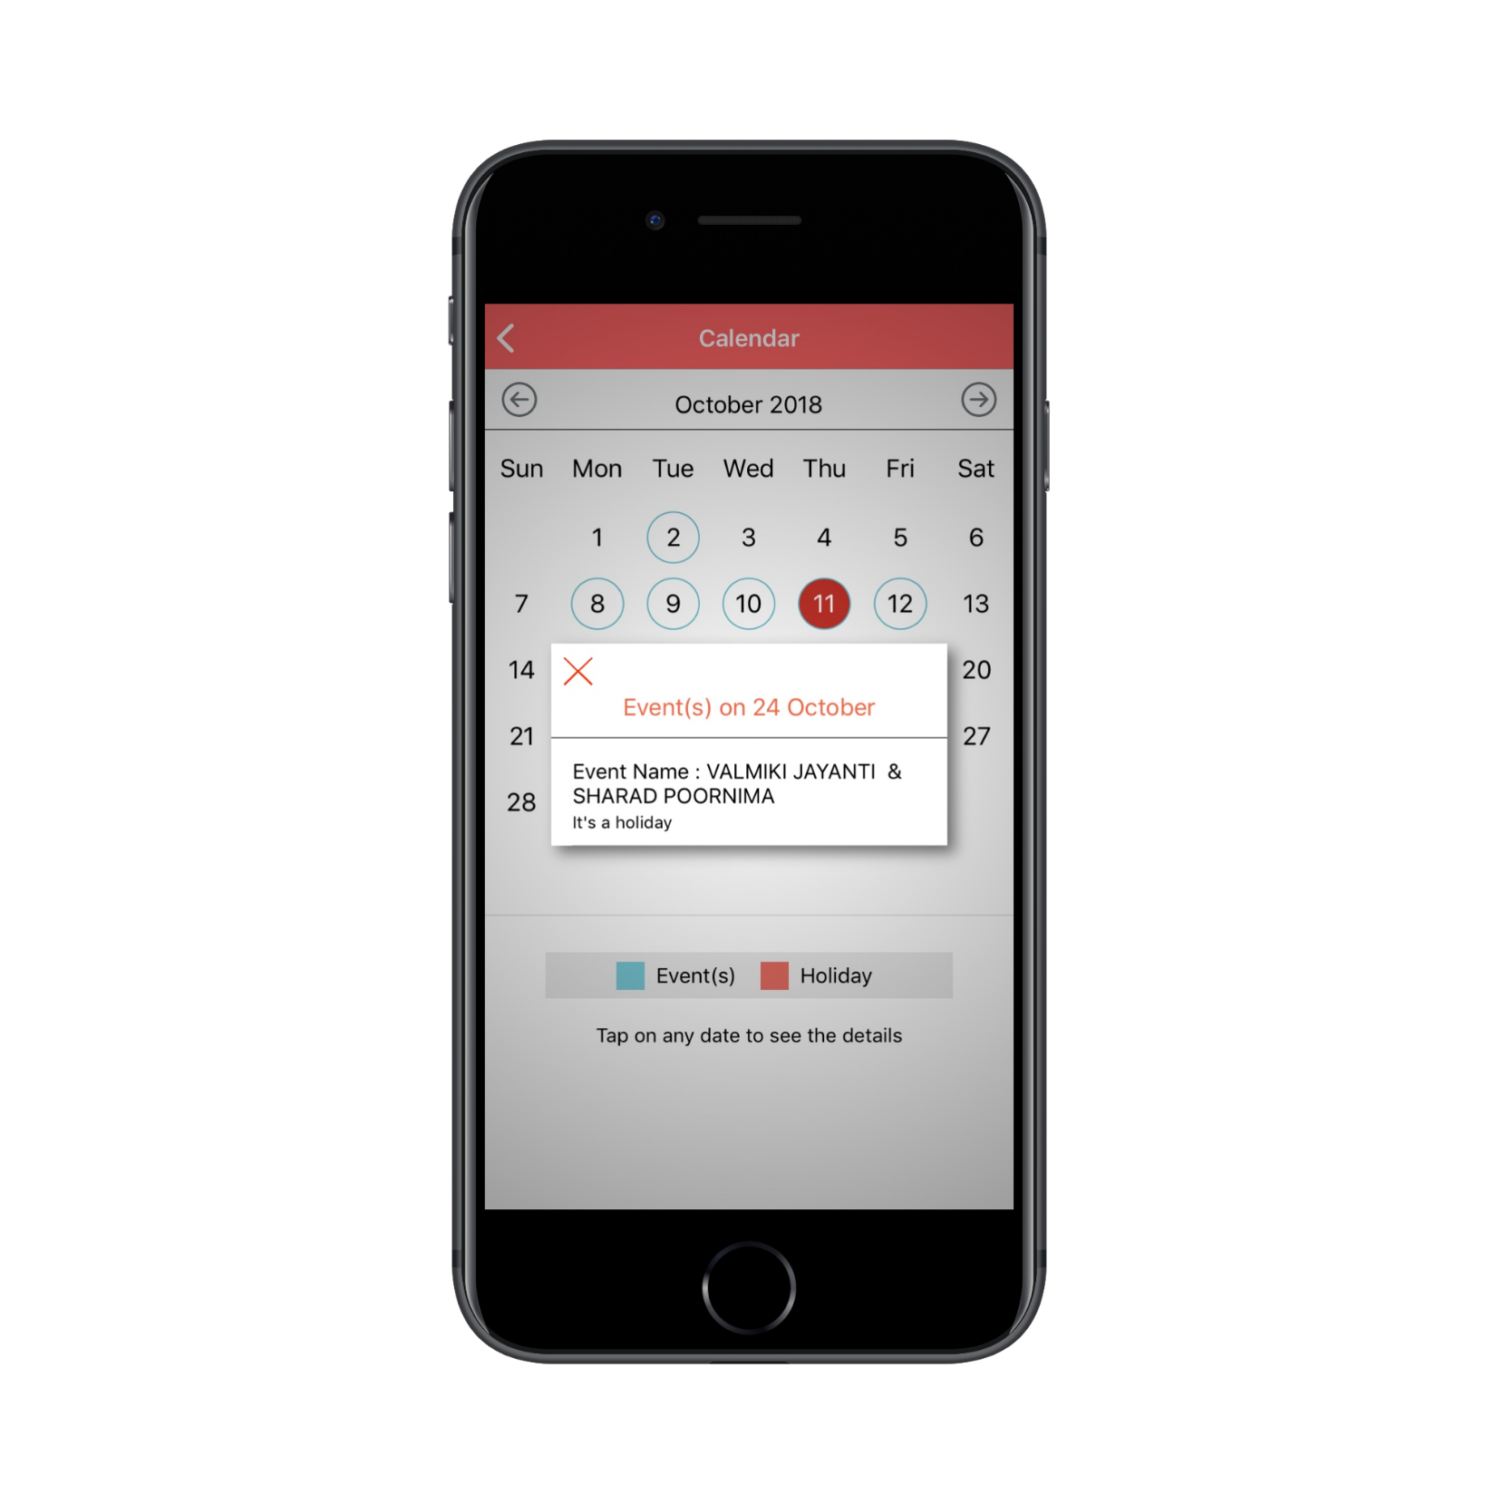
CALENDER & CIRCULARS
Circulars
Calendar and Events

Slide 9
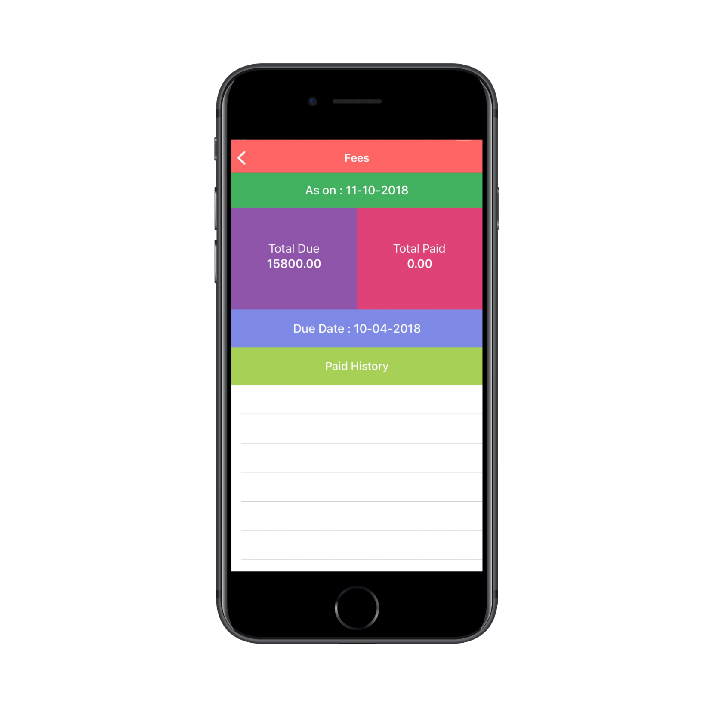
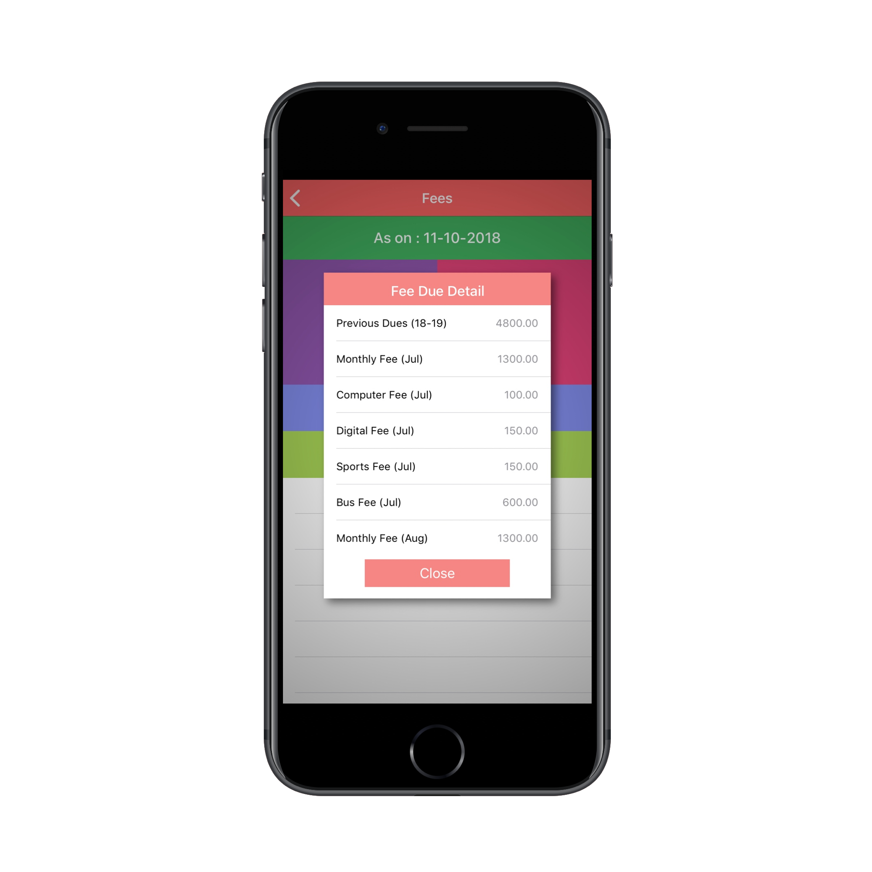
FEE DETAIL
Total Fee Due
Fee Detail

Slide 10
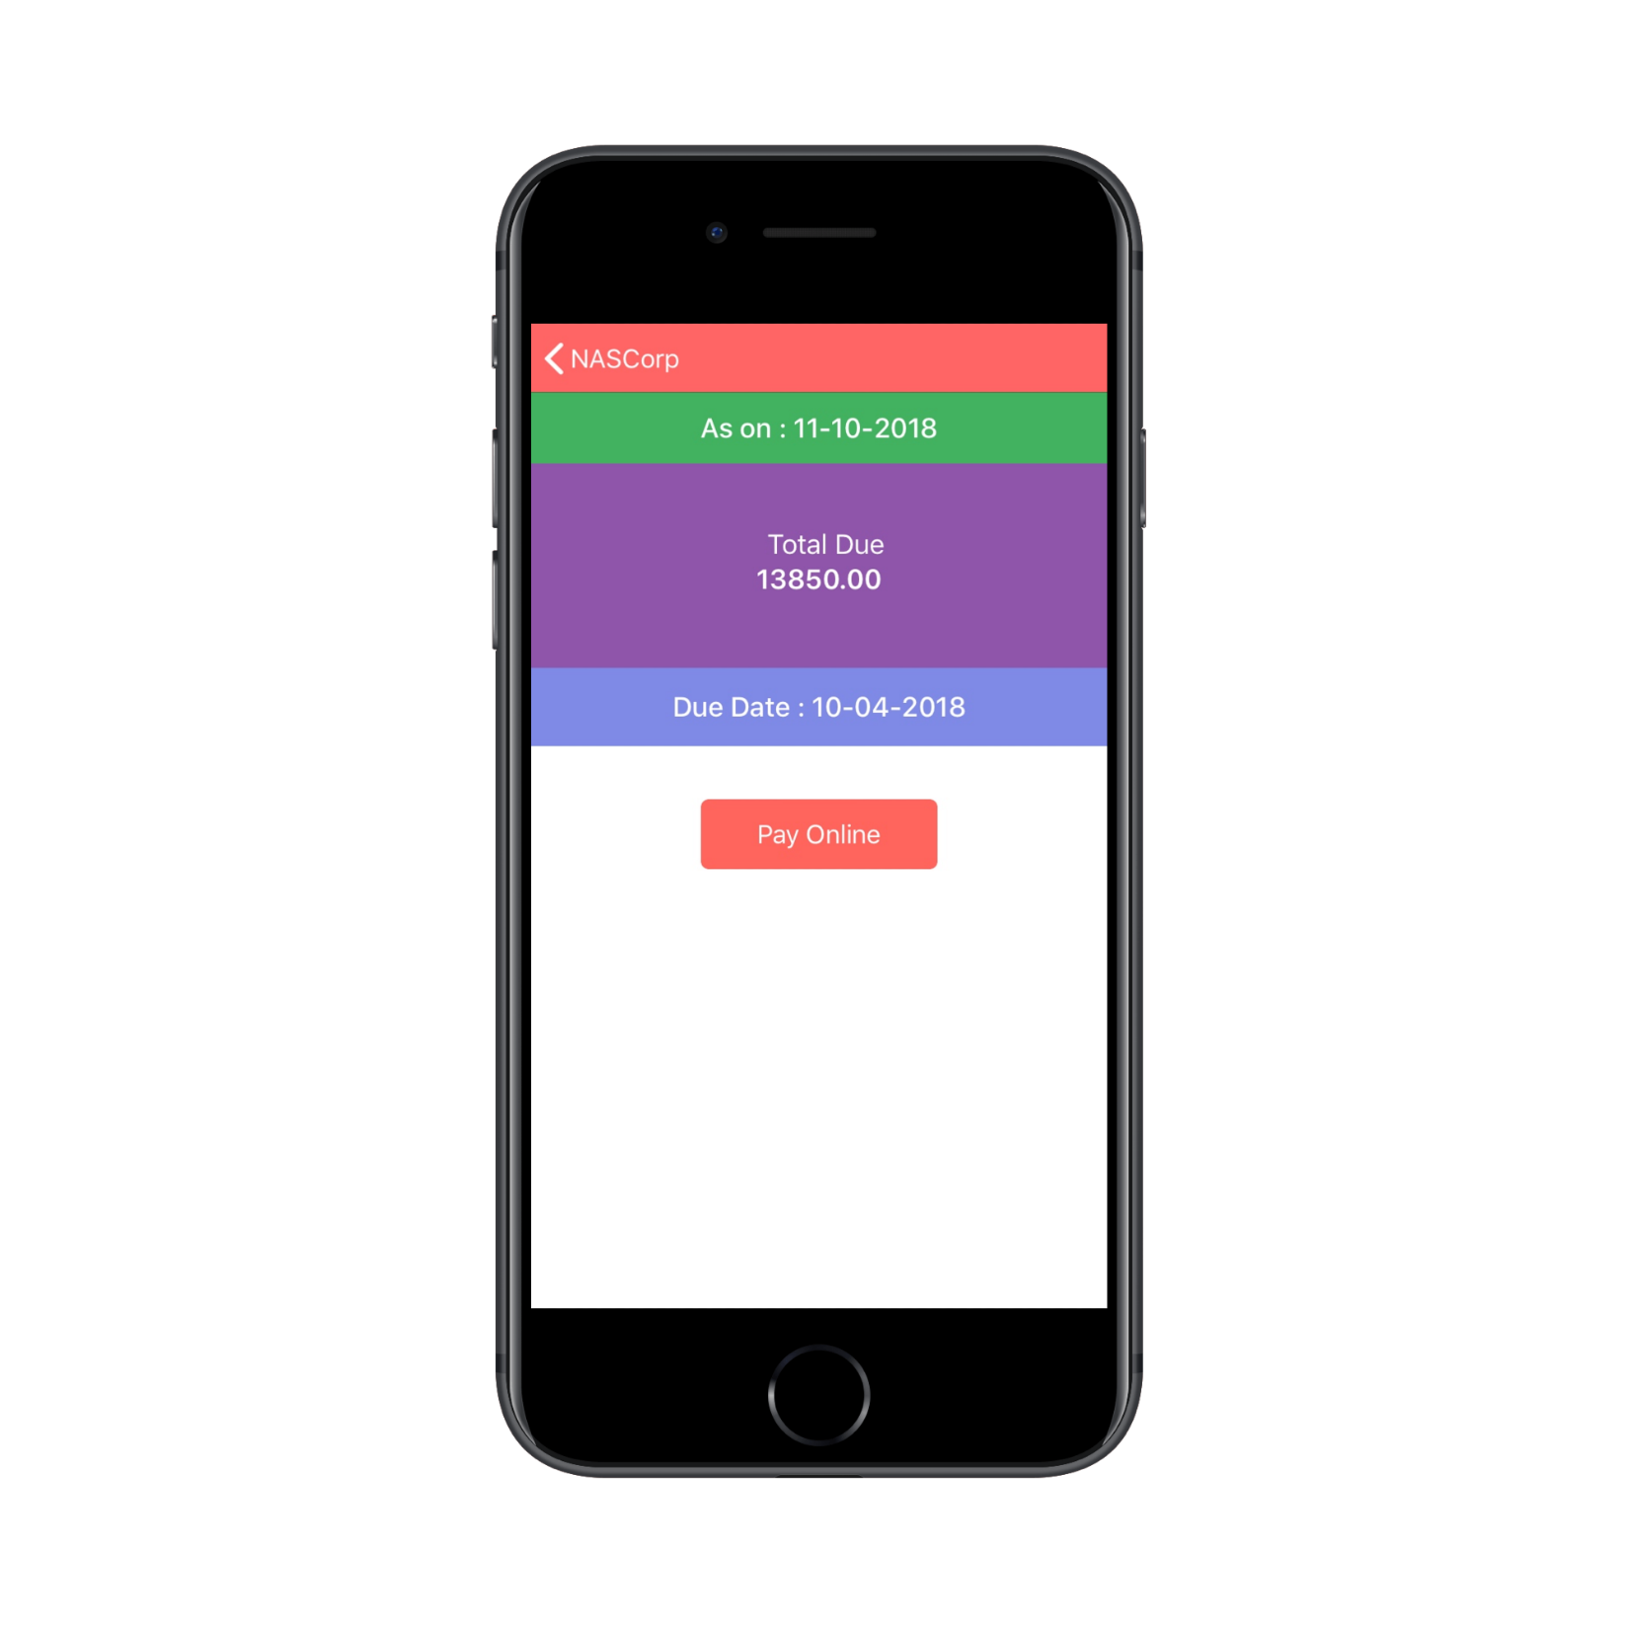
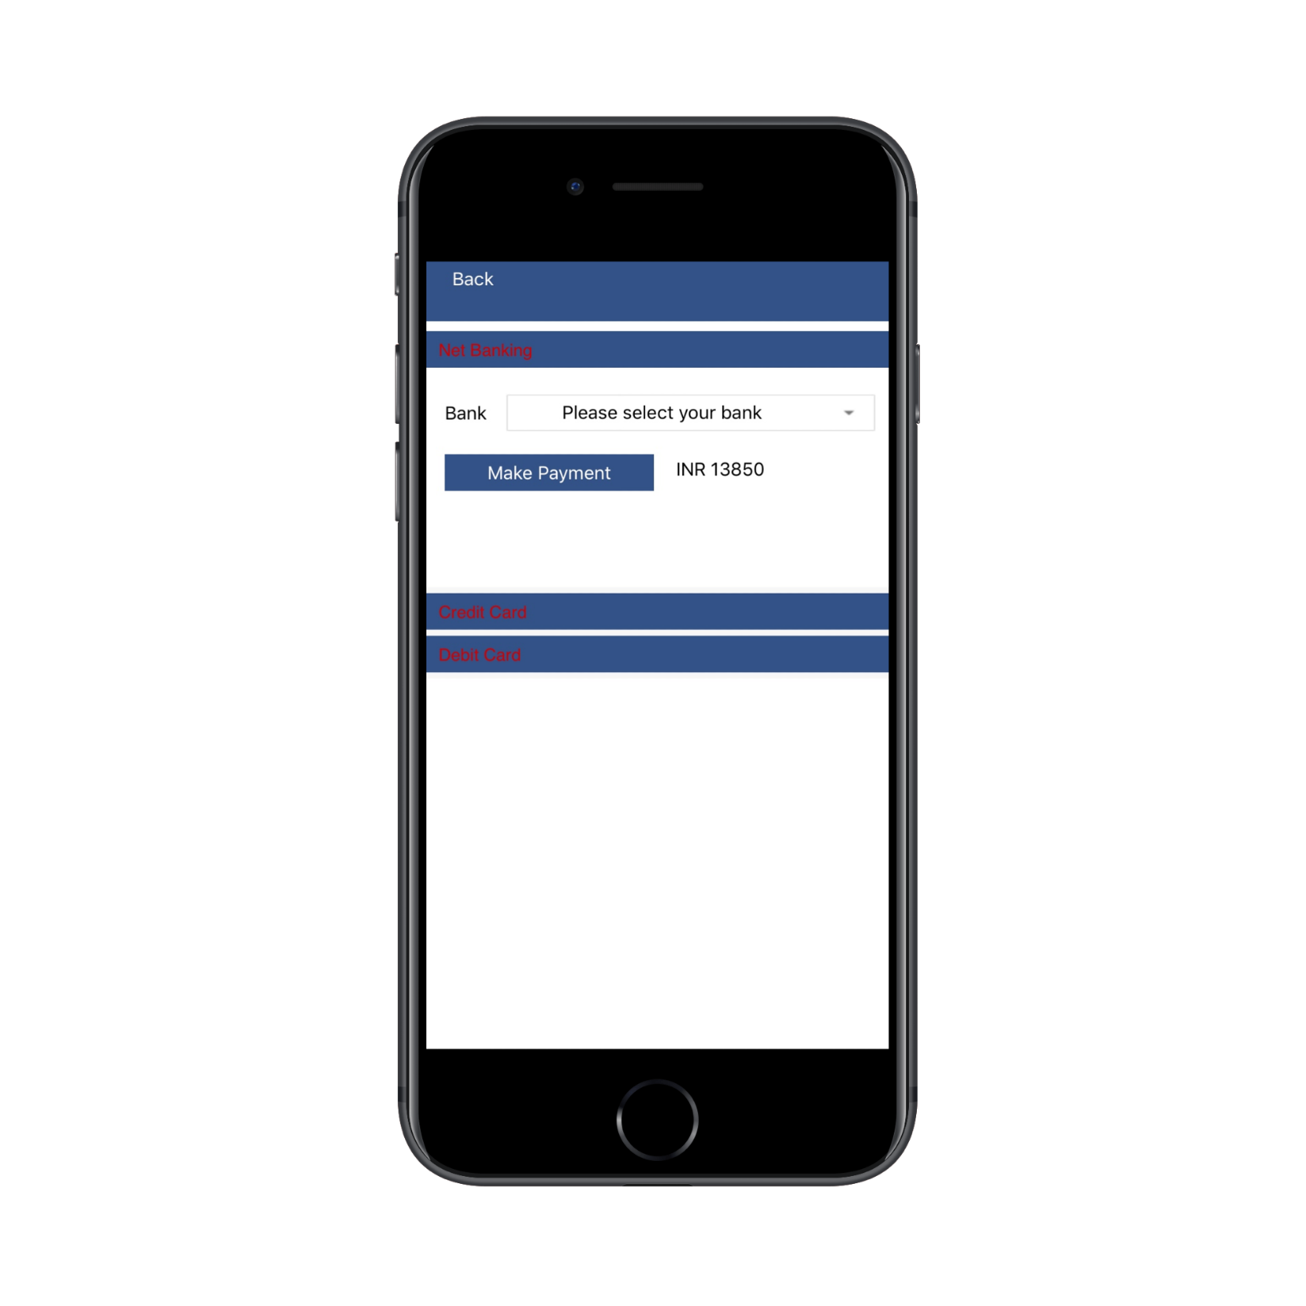
ONLINE FEE PAYMENT
Online Fee Payment
Select your bank

Slide 11
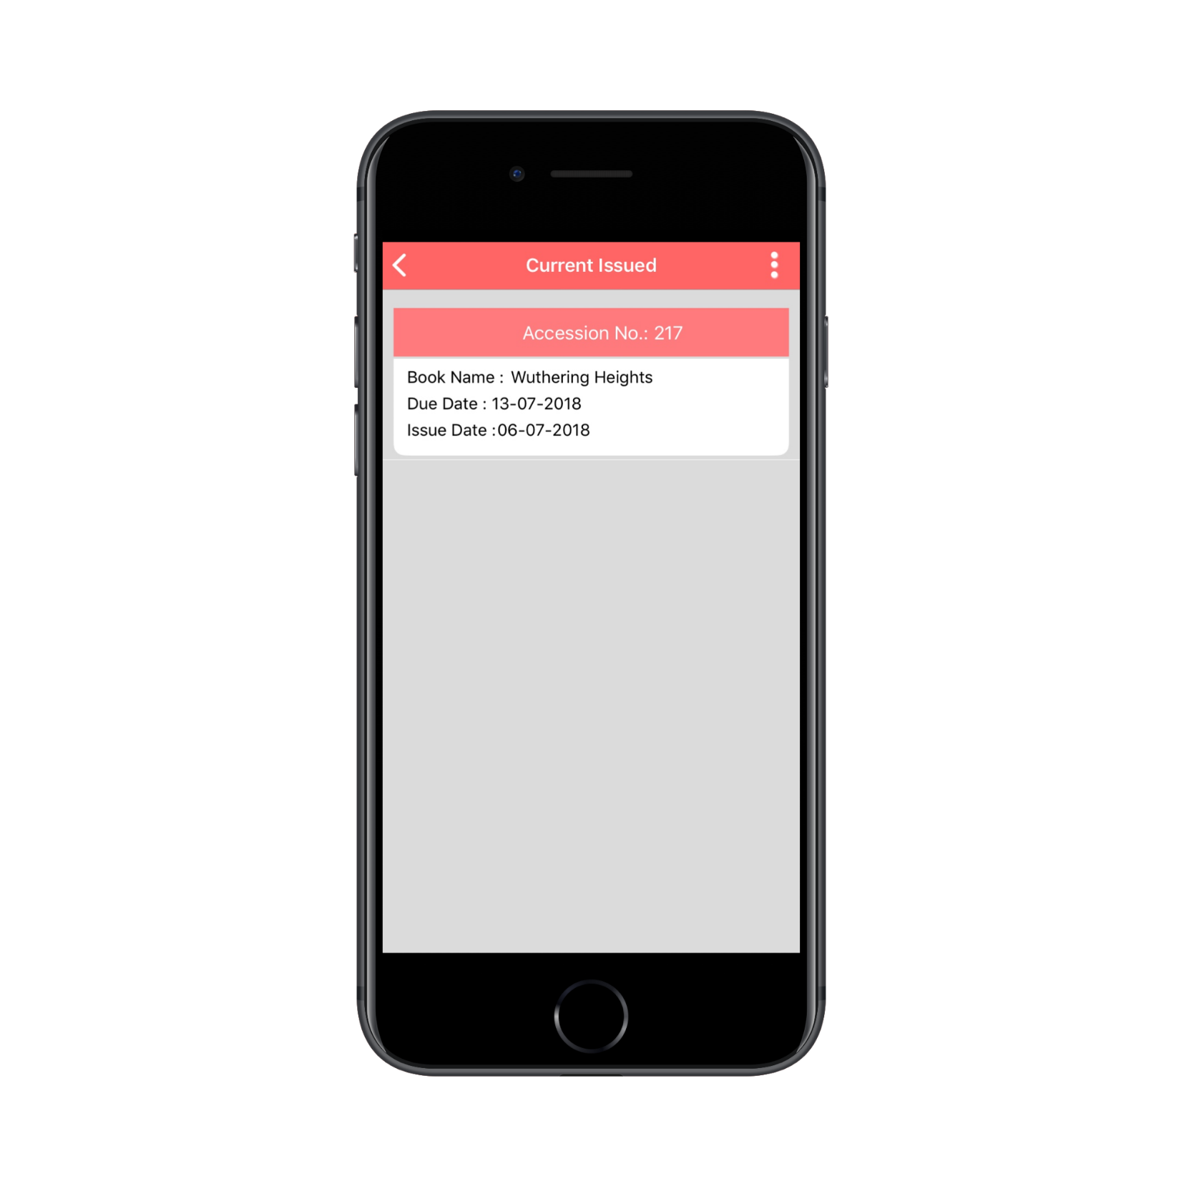
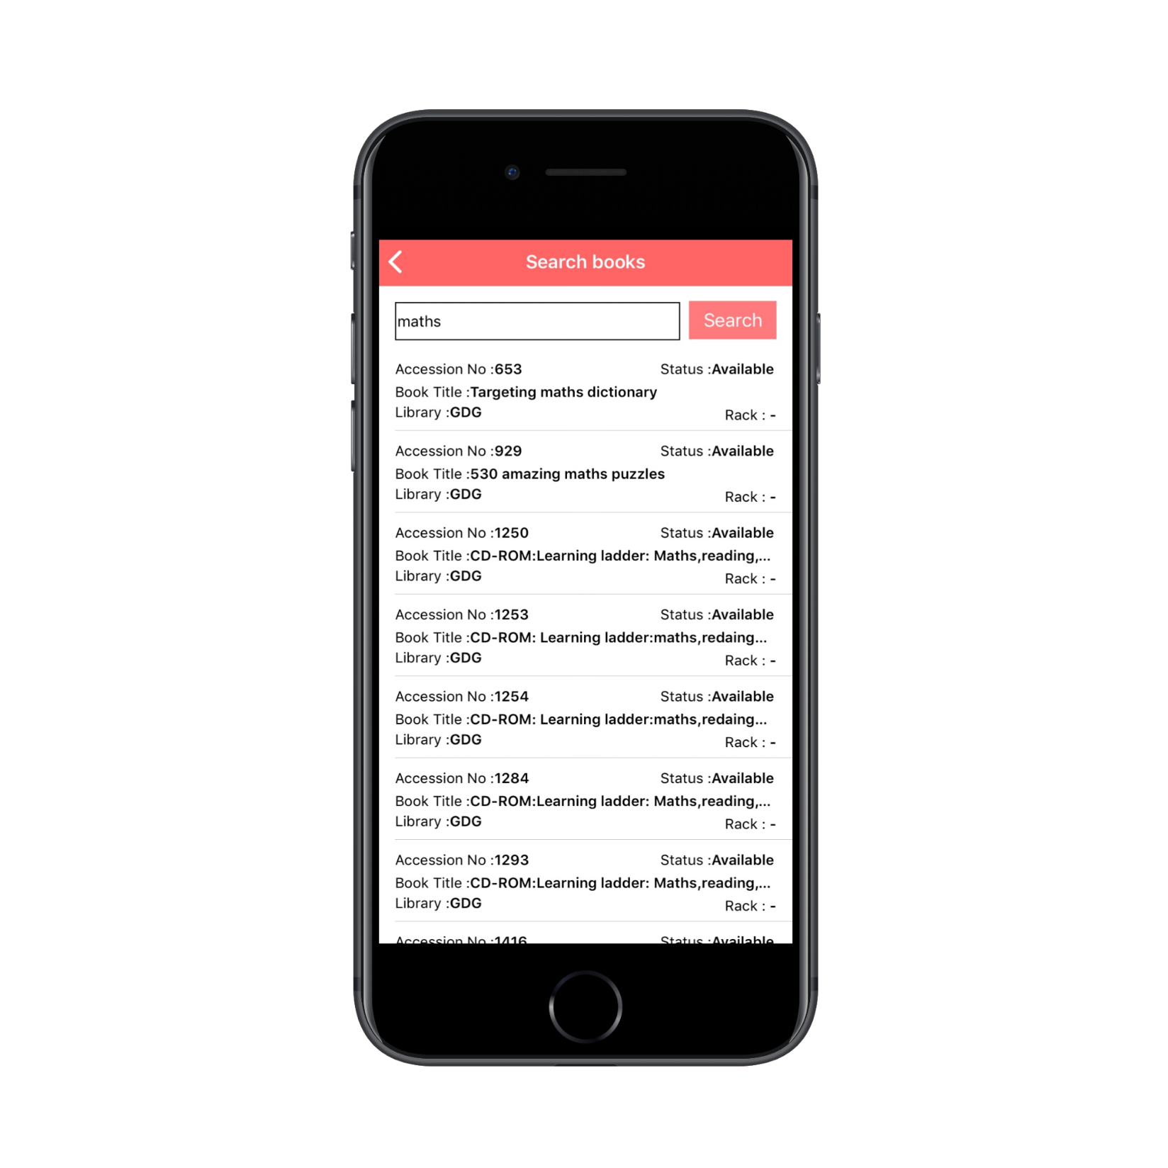
LIBRARY ONLINE
Issue History
Search a book Online

Slide 12
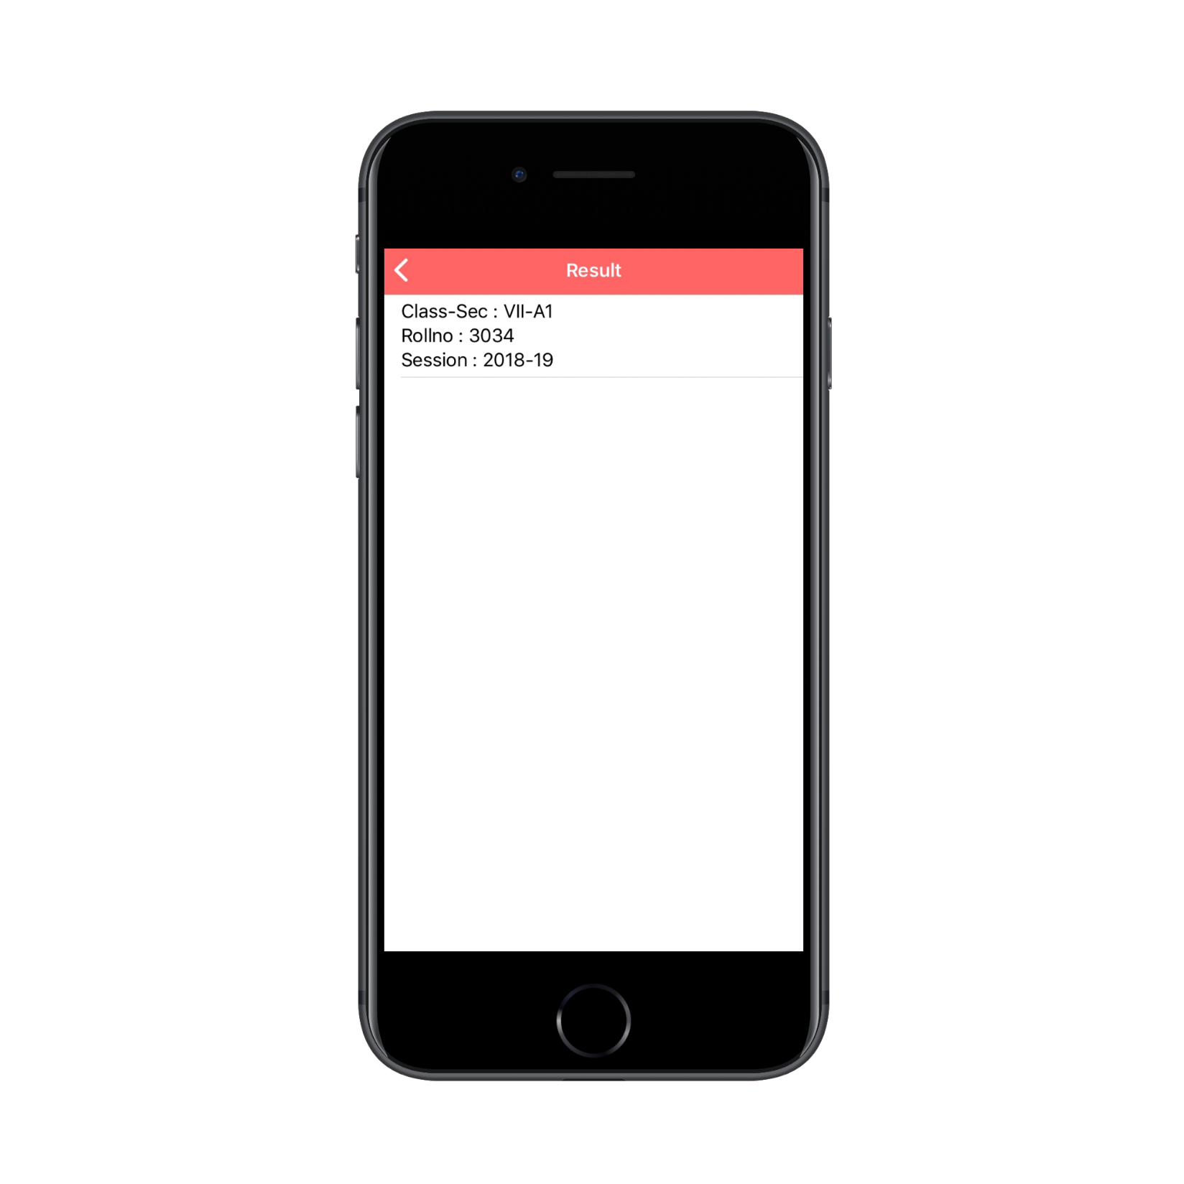
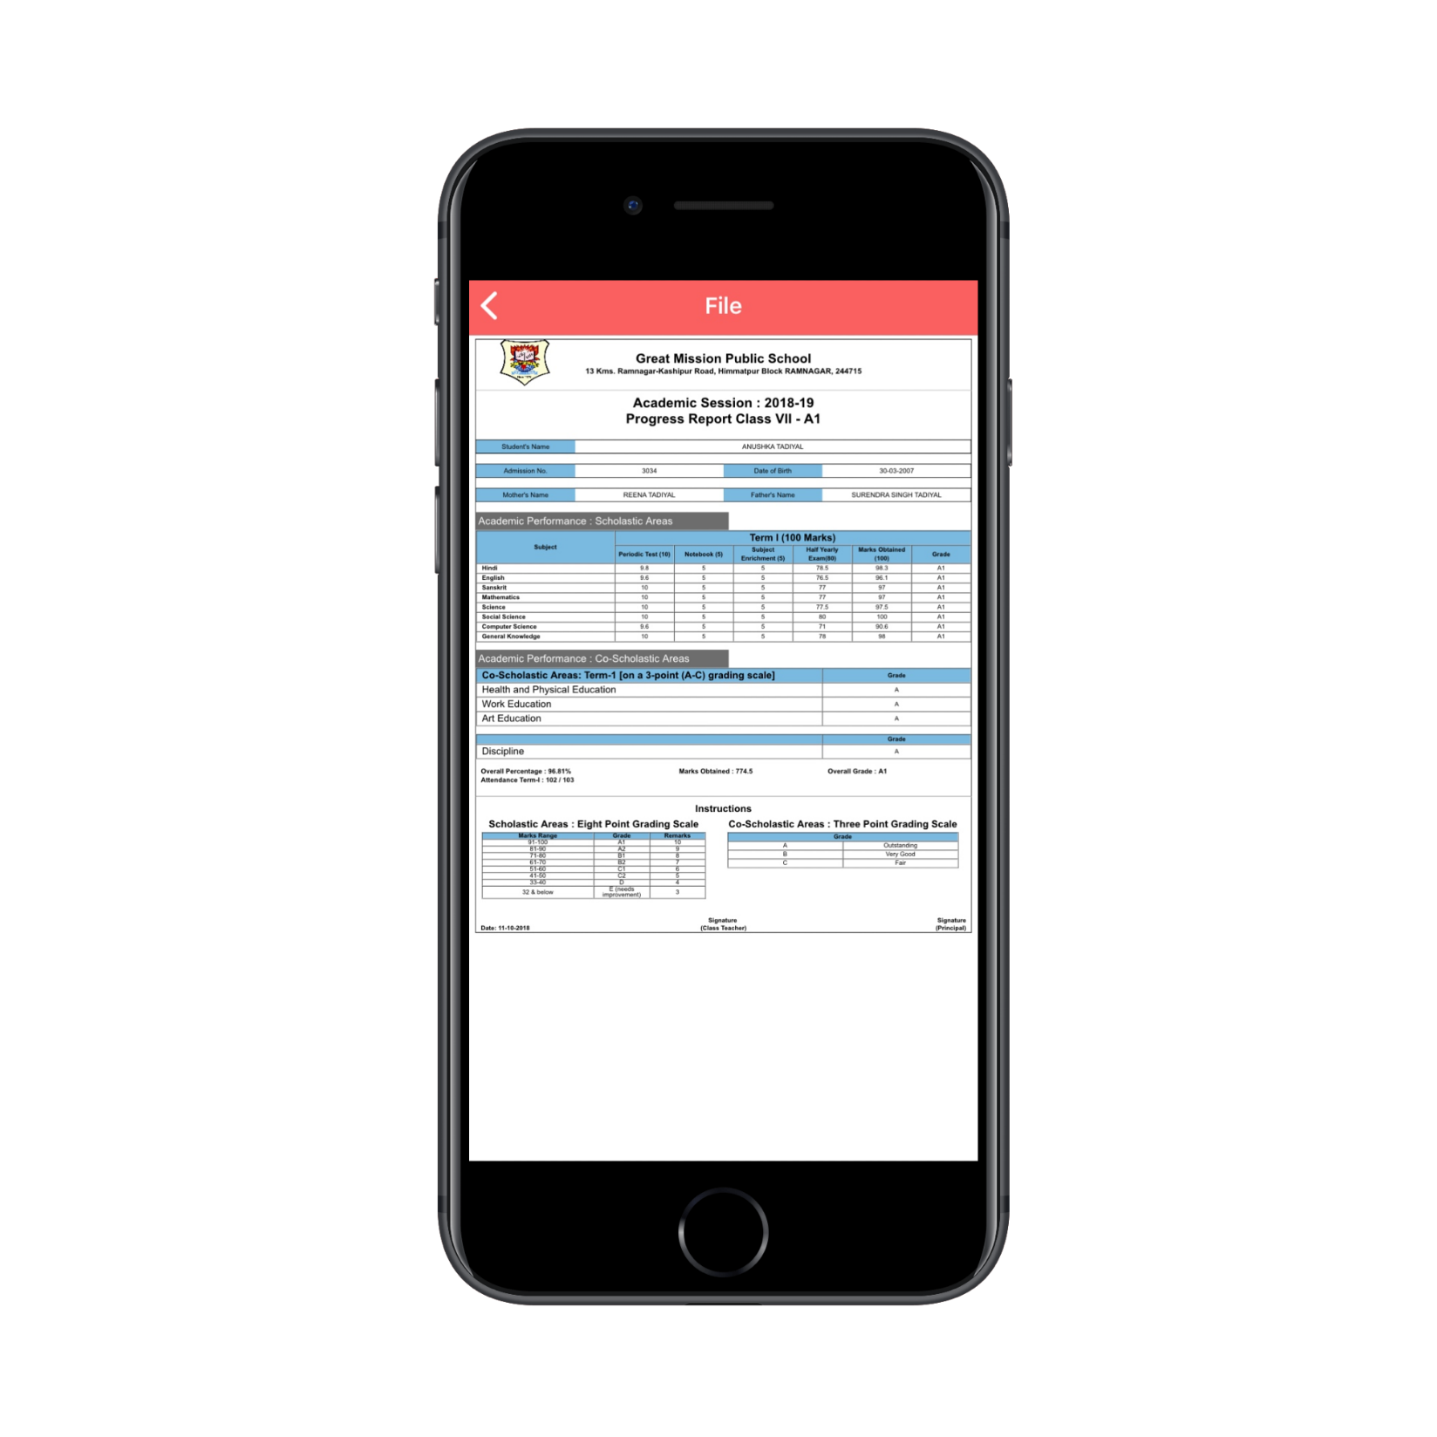
REPORT CARD ONLINE
Published Report cards
View Report Card

Slide 13
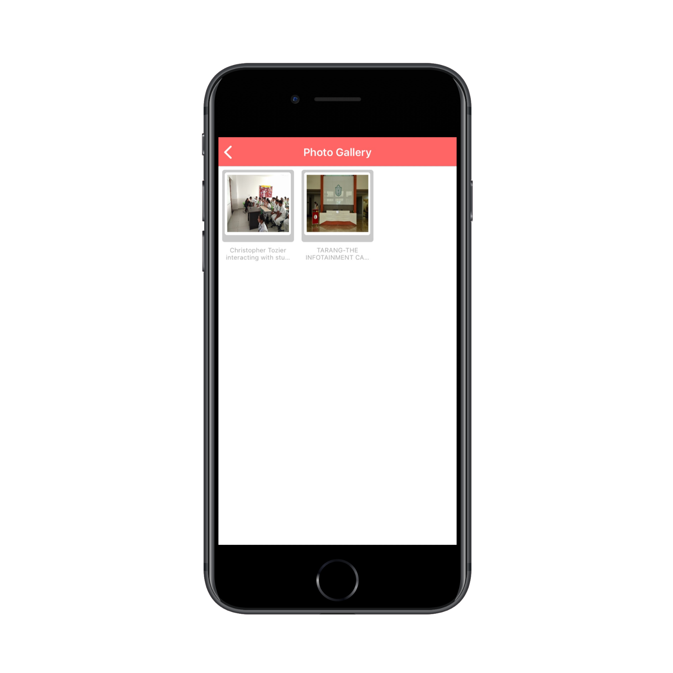
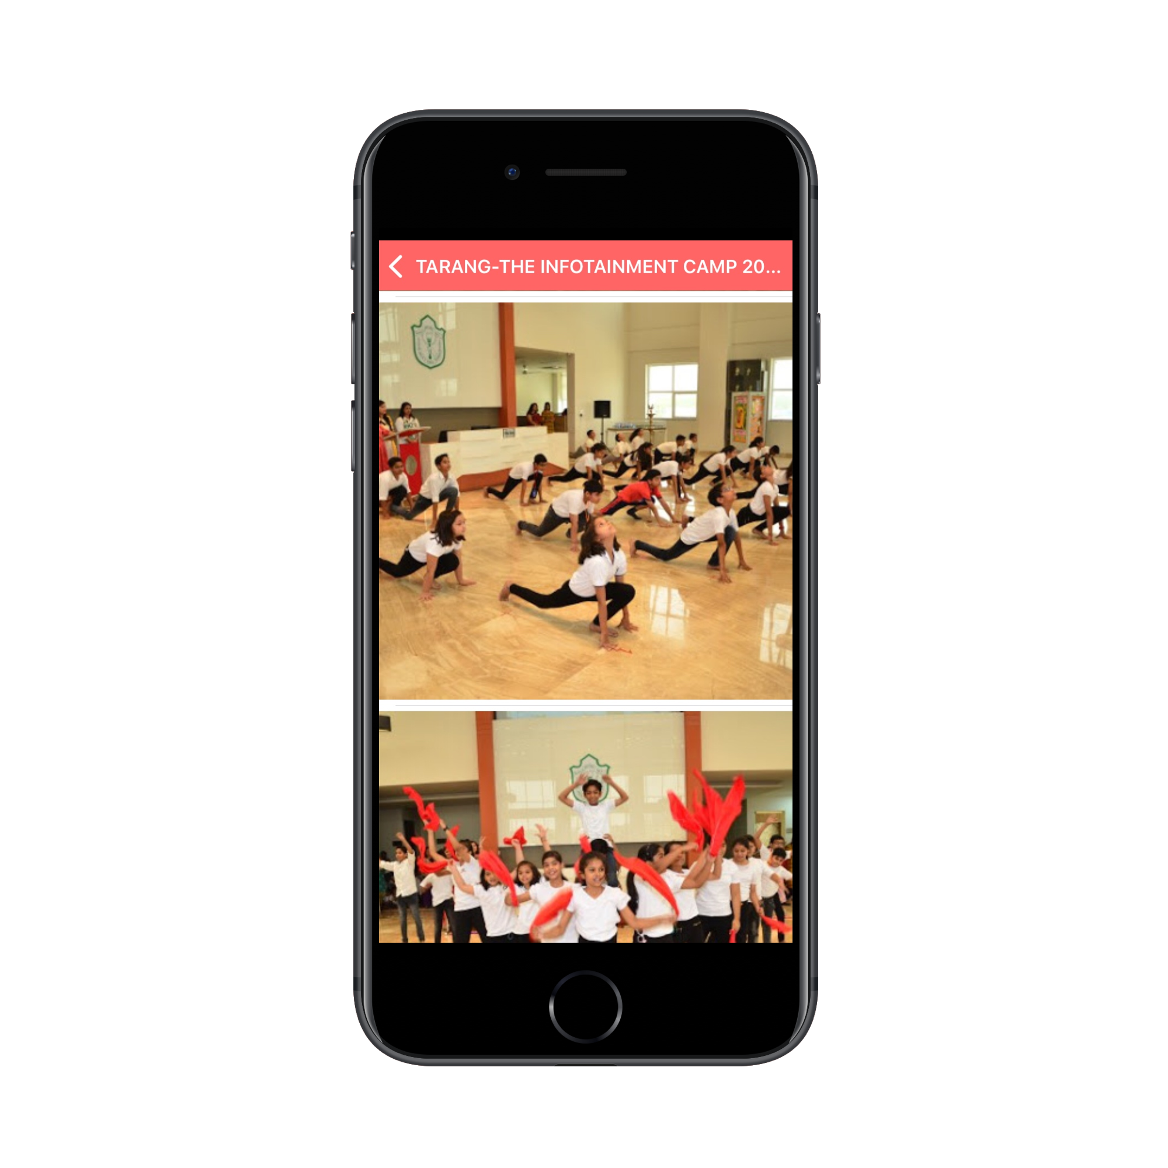
IMAGE GALLERY
Photo Gallery
View Photos

Slide 14
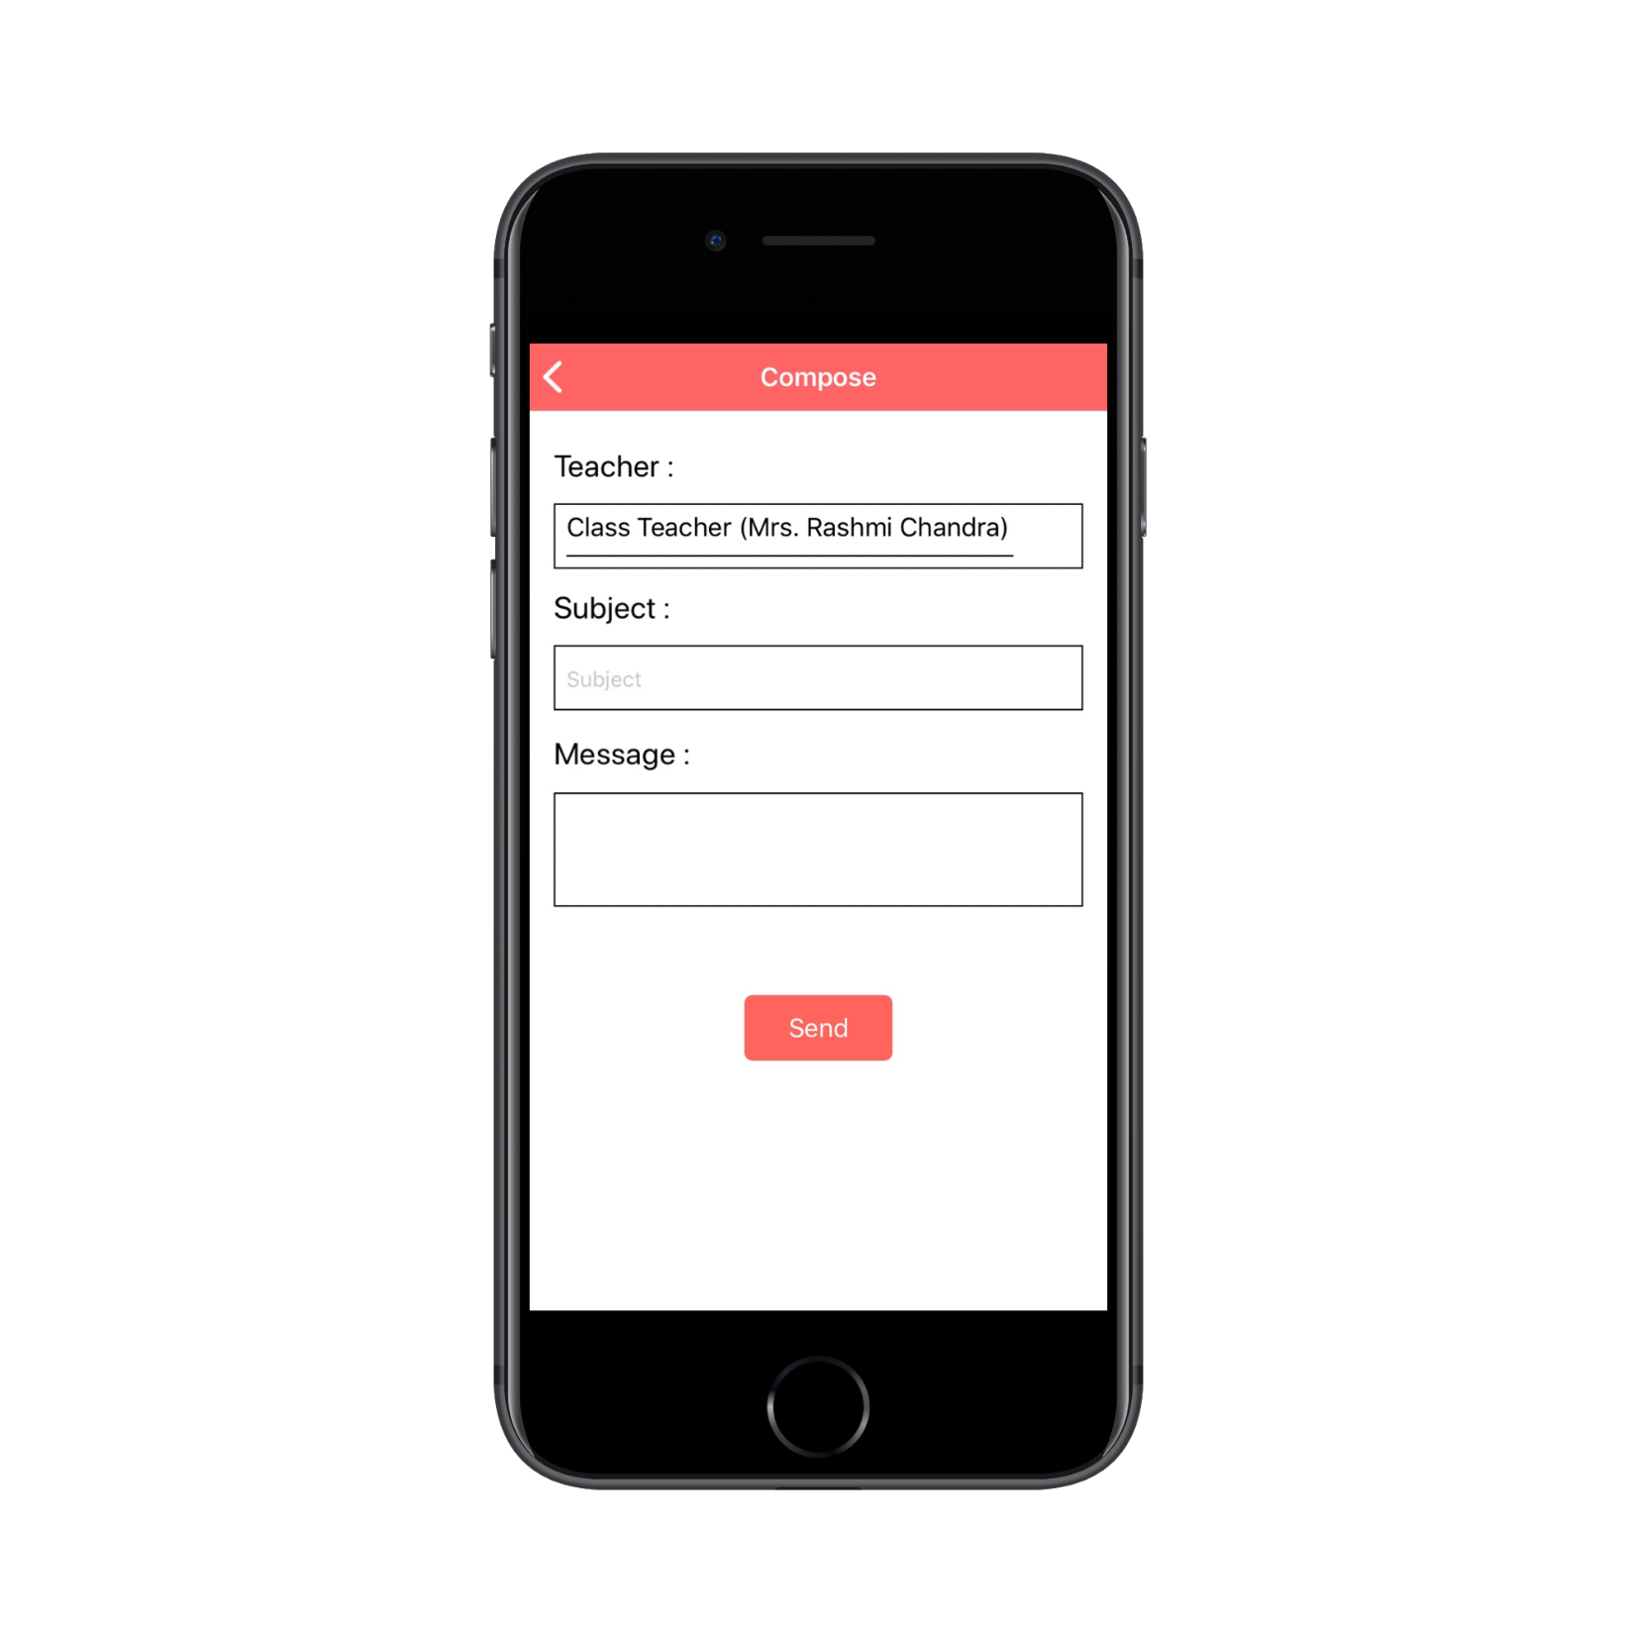
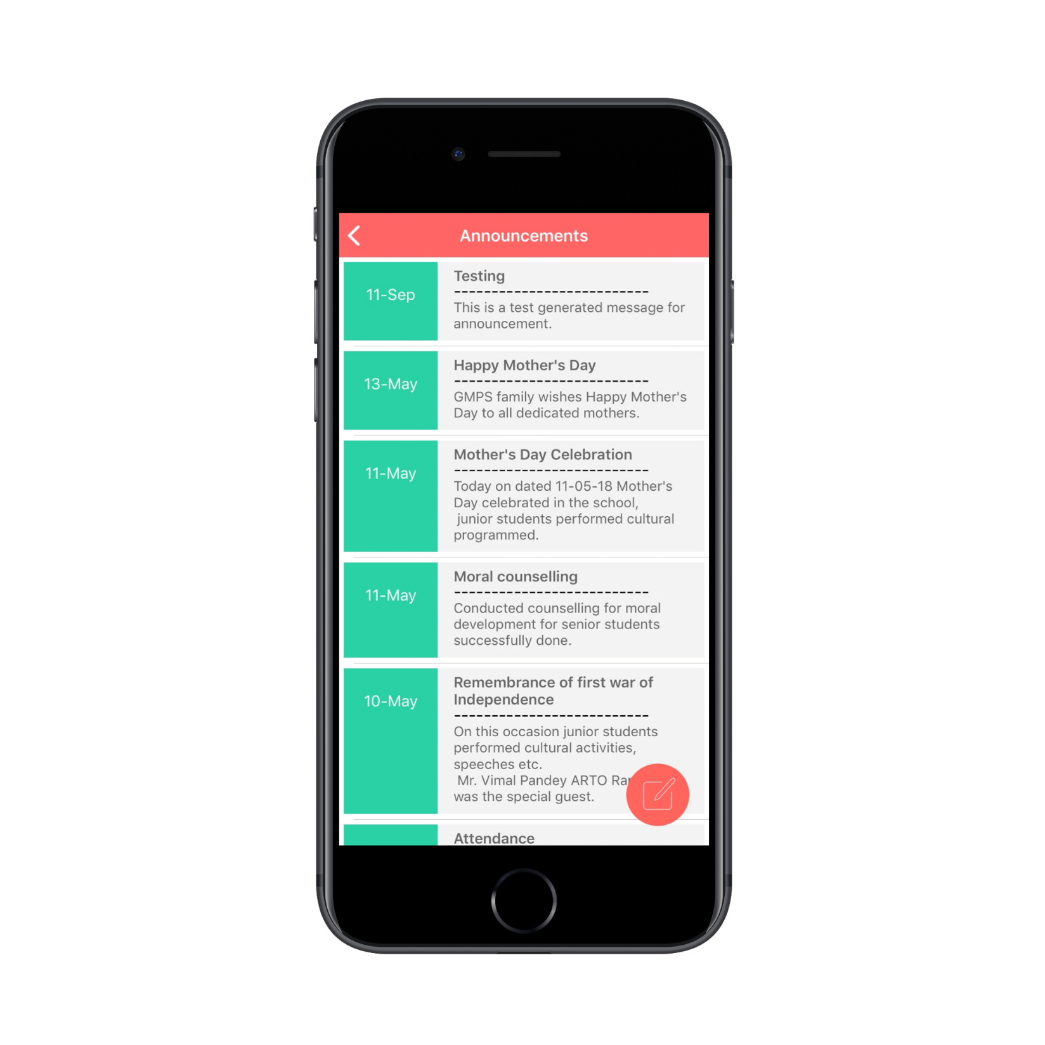
COMMUNICATION
Communication
Announcements

Slide 15
Thank You

